Slide 1
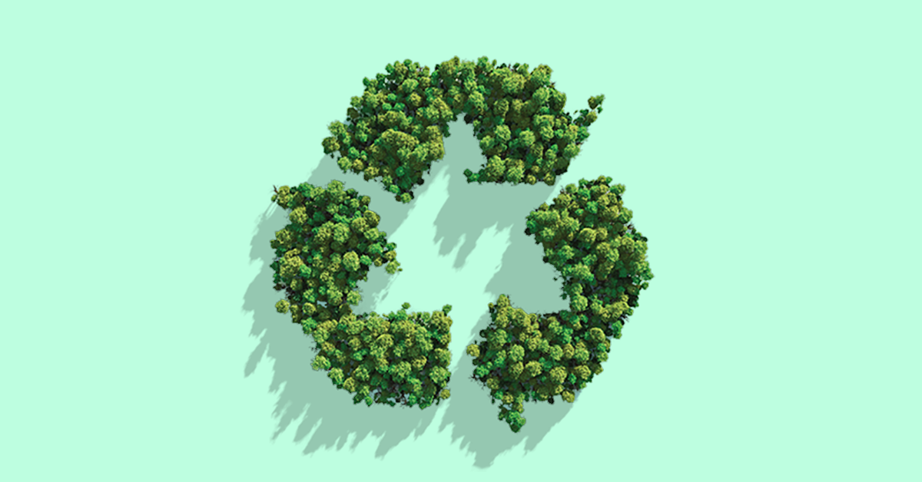


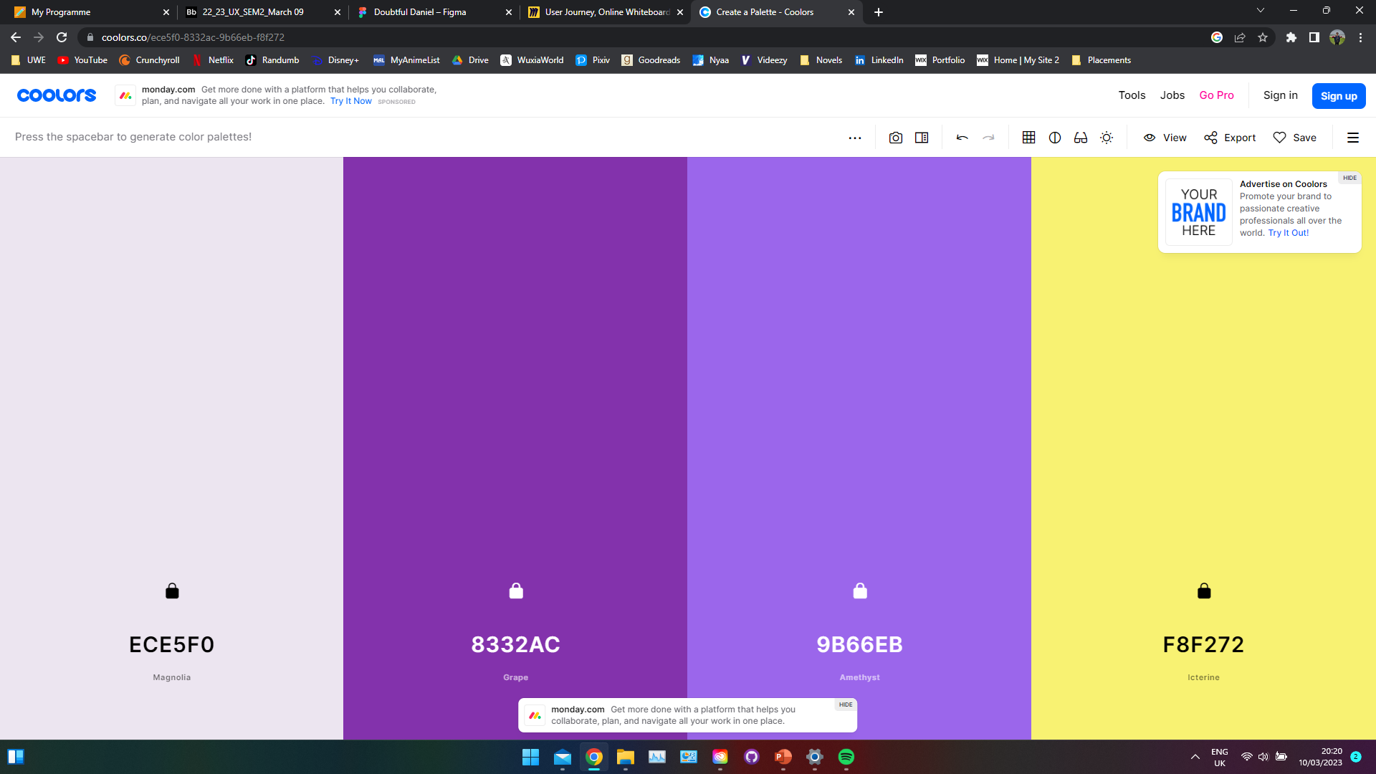
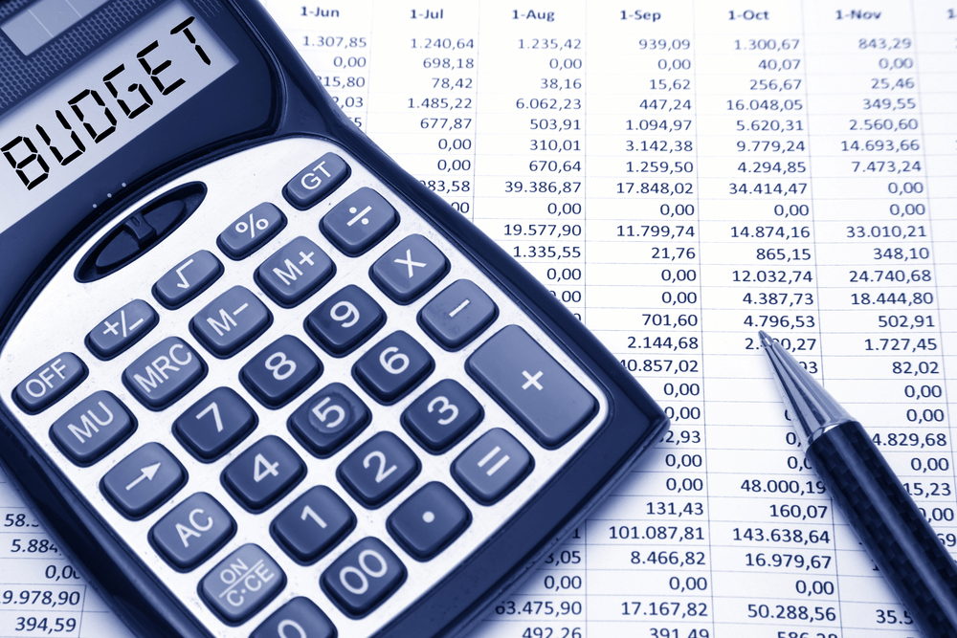
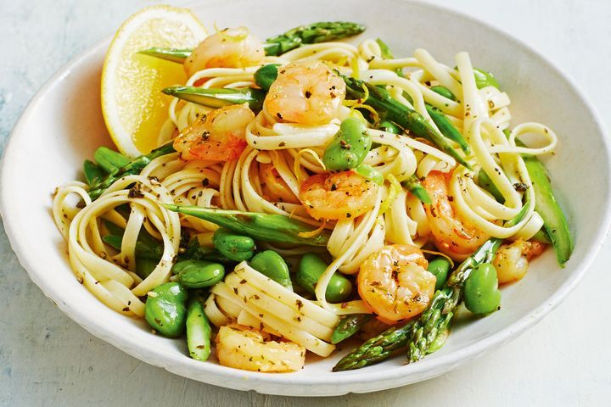

Slide 2
Elevator pitch
This app is catered towards university students looking to make a change in their eating habits. This app is designed to aid users in being sustainable while facing many hindrances from external sources outside of their control.
Daisy is a service which provides users with sustainable recipes while informing users of the importance of food all while keeping in mind barriers such as finance. The main benefit of this is informing all our users the significance of sustainability and how small changes to their food habits can create a big impact on the environment around them.
Unlike BBC Good Food Daisy will be targeted towards a younger demographic ranging from 18-24 as that is the main bulk of student ages. This will mean a lot of the features will be more stylised to an intuitive navigation system, similar to Instagram which was an app favourite in my research.
Daisy will aid in helping its users with recommendations and congratulating them for being apart of a thriving community who aims to be sustainable together.

Slide 3
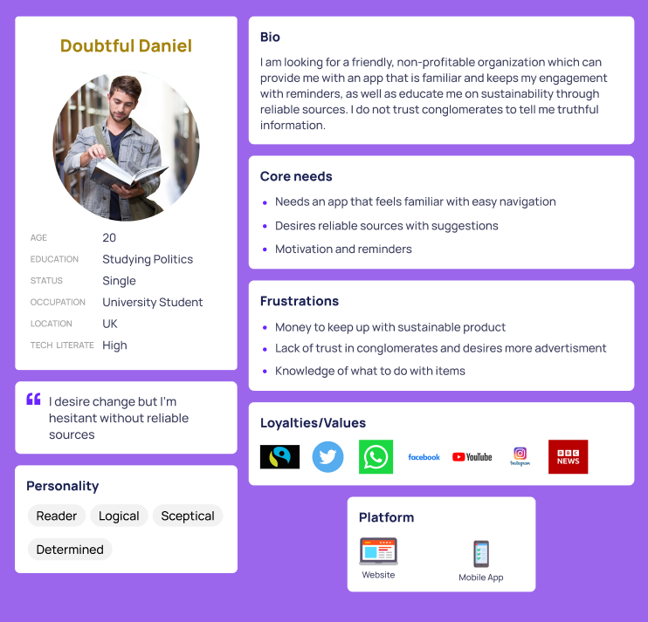
Persona
v

Slide 4

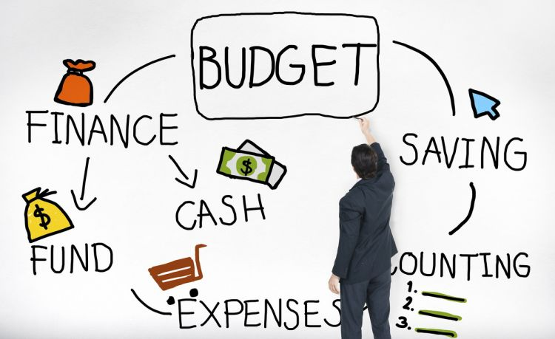
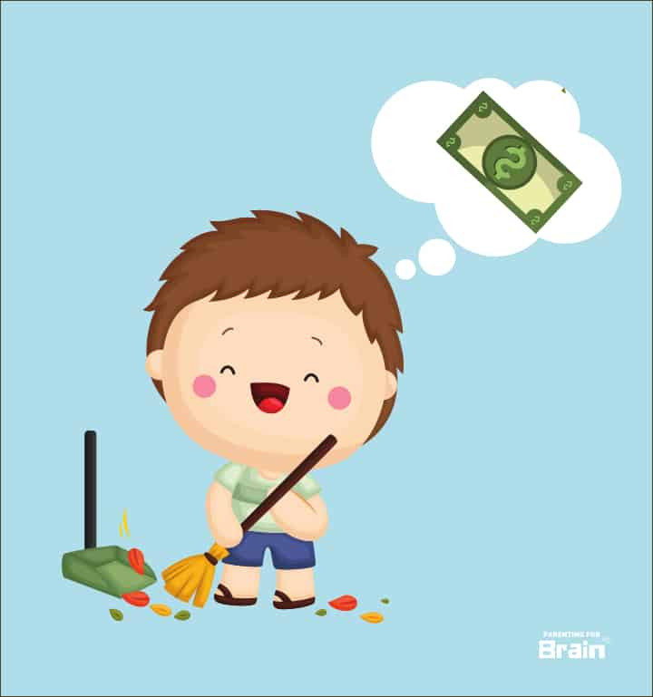
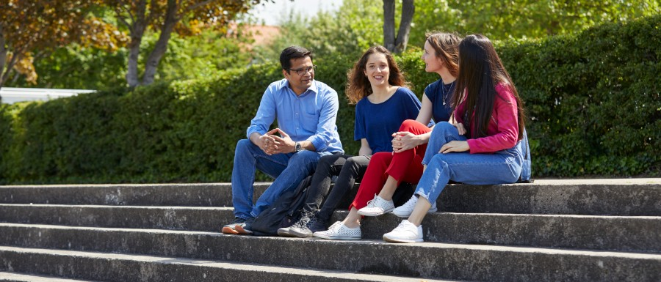


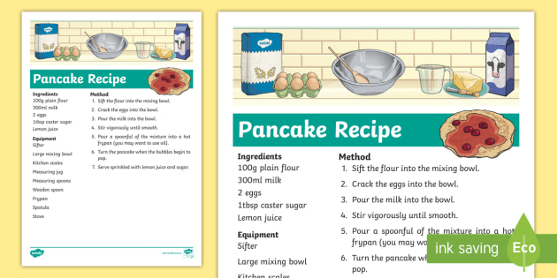
Mood Board before User Journey

Slide 5


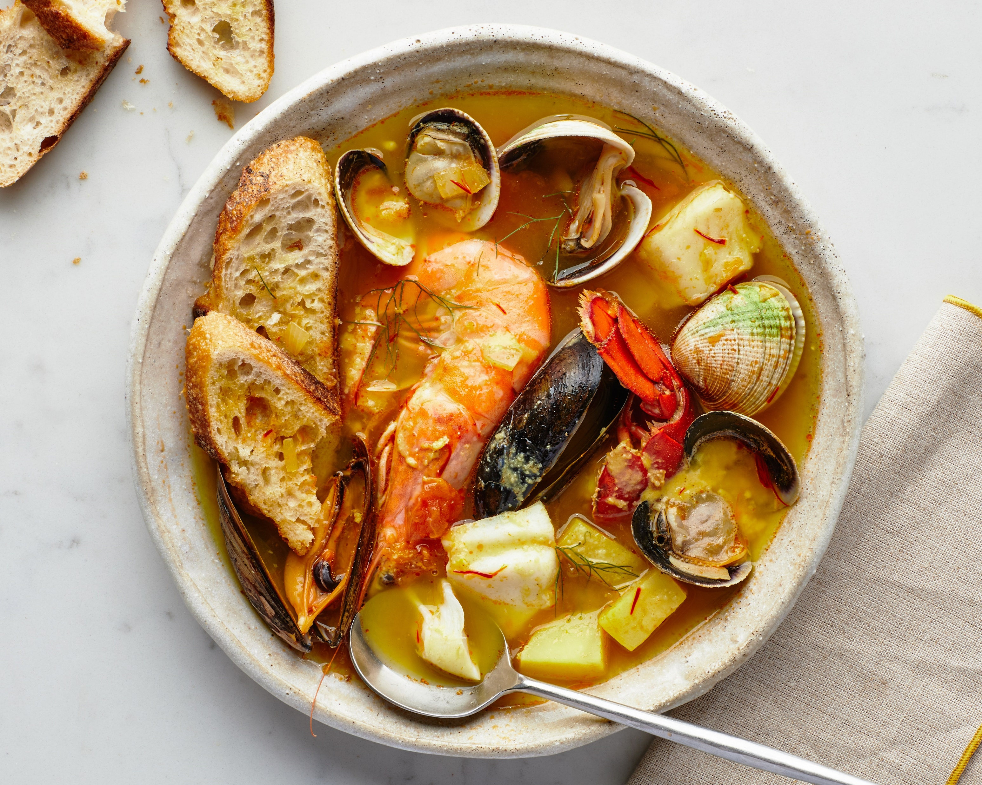

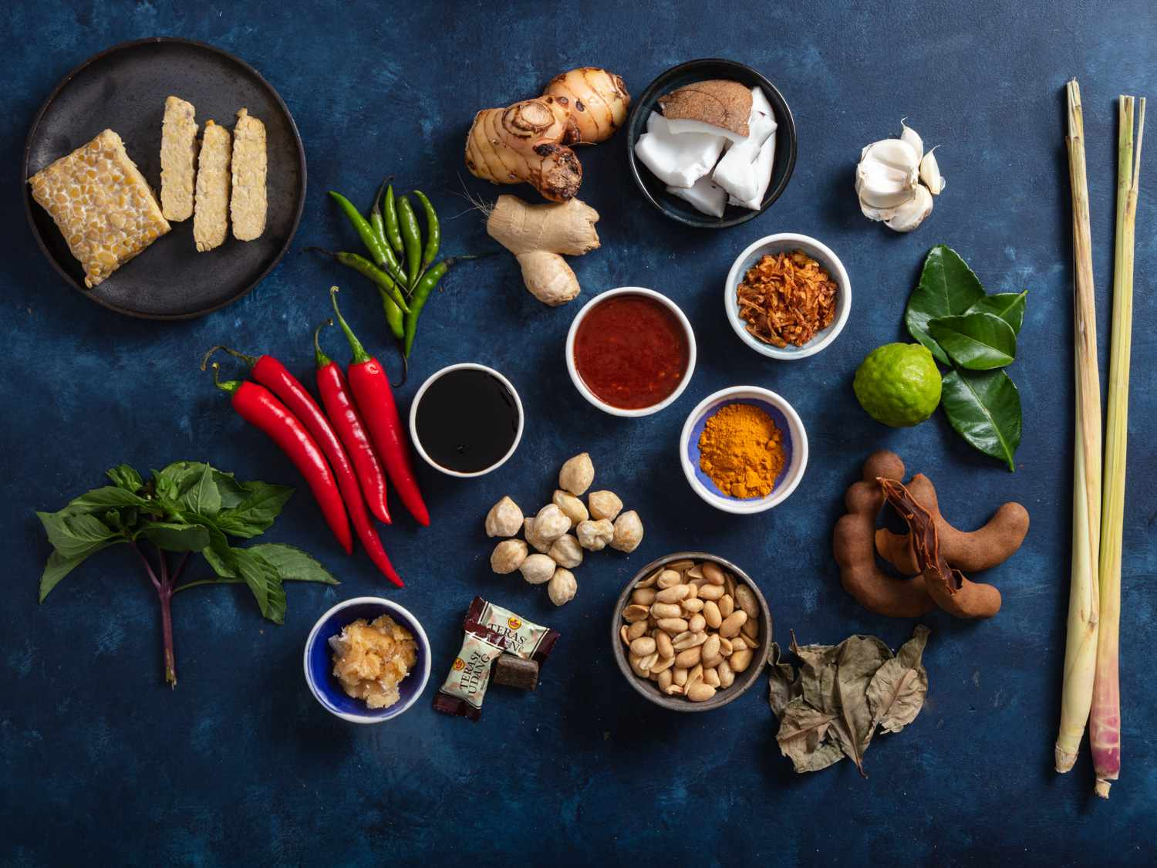
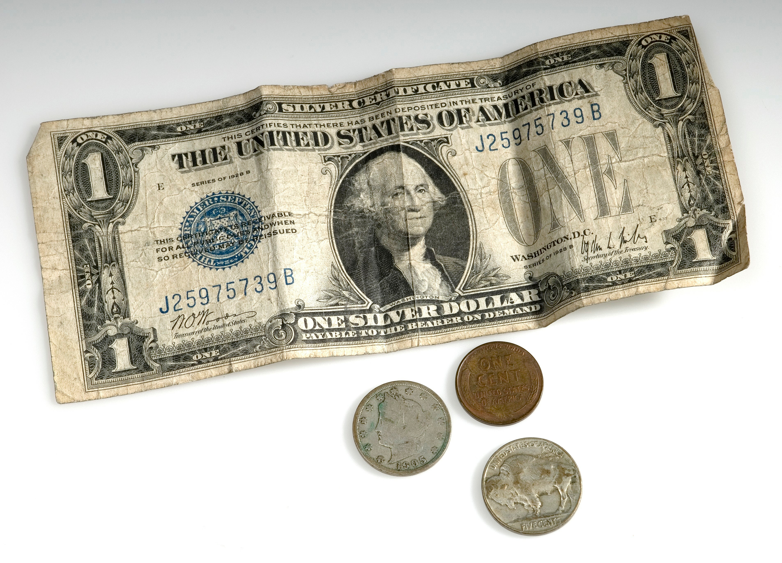

Mood Board for User Journey

Slide 6
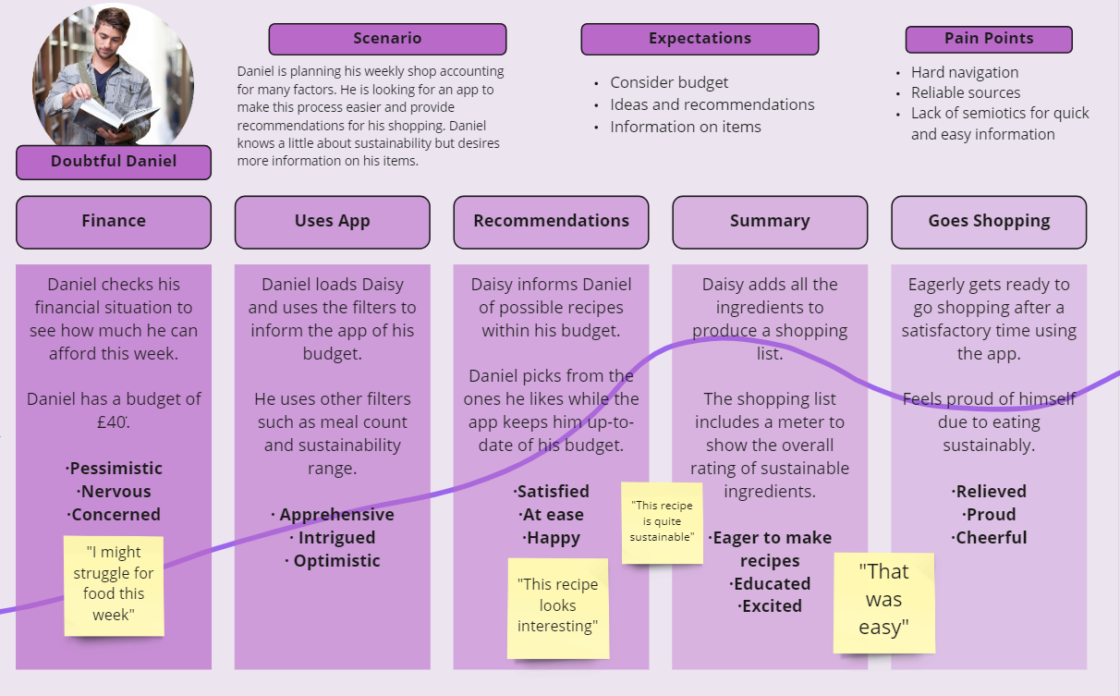
User Journey
v

Slide 7
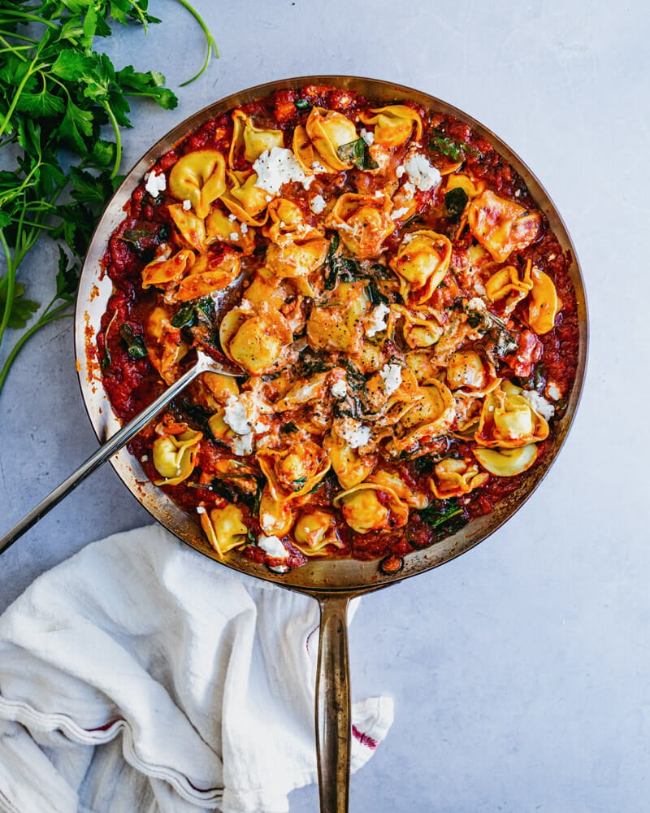


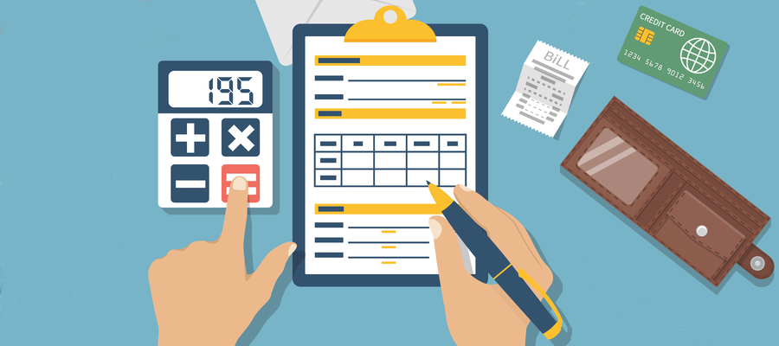
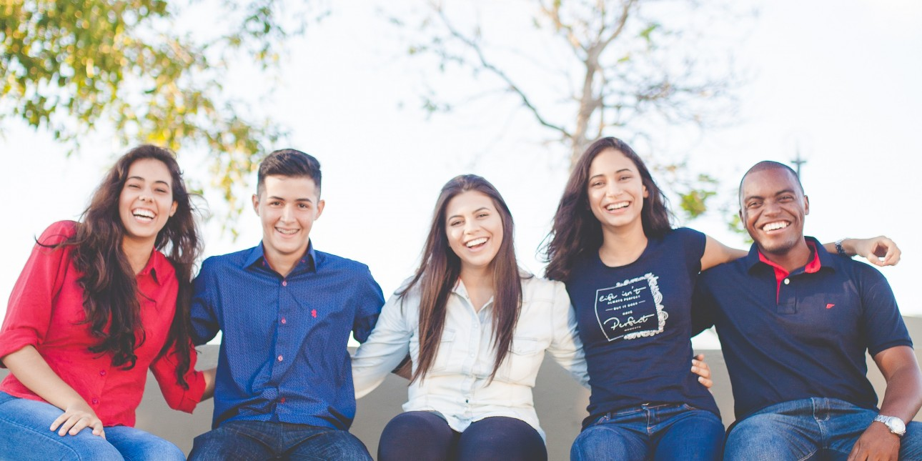

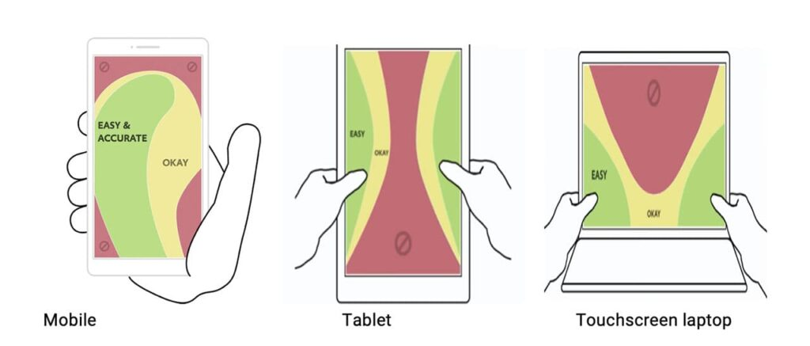

Mood Board for User Needs

Slide 8
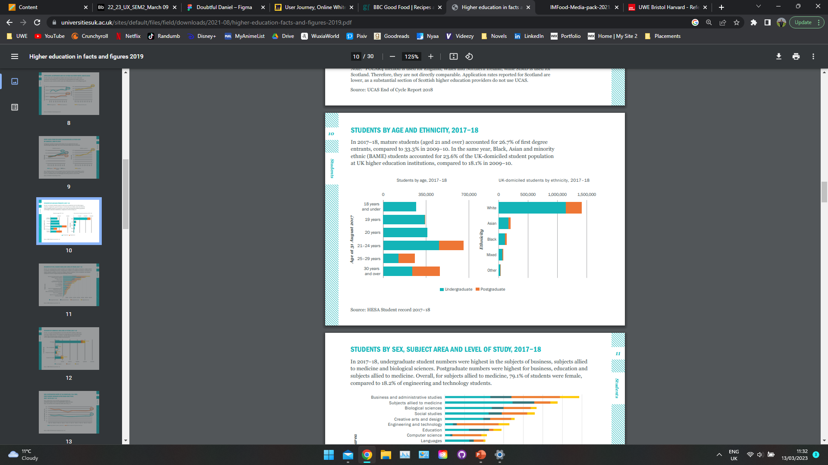
Research – Secondary research
v
“In 2017–18, mature students (aged 21 and over) accounted for 26.7% of first degree entrants”
Universities UK (2019) High Education in Facts and Figures 2019 [online]. London: Universities UK. Available from: https://www.universitiesuk.ac.uk/sites/default/files/field/downloads/2021-08/higher-education-facts-and-figures-2019.pdf [Accessed 13 March 2023]

Slide 9
Research - Secondary Research
“University policy to improve students’ diets should incorporate efforts to promote student engagement in cooking and food preparation, and increased availability of low-cost healthier food items.”
E. F. Sprake (2018) Dietary patterns of university students in the UK: a cross-sectional study. Available from: https://nutritionj.biomedcentral.com/articles/10.1186/s12937-018-0398-y [Accessed 25 October 2022]
“…the most common factors that are reported as barriers to a healthy diet are time constraints, the high price of food items, and their availability, followed by the lack of motivation in food preparation…”
(Sogari, G (2018) College Students and Eating Habits: A Study Using An Ecological Model for Healthy Behavior. Available from: https://www.ncbi.nlm.nih.gov/pmc/articles/PMC6315356/ [Accessed 25 October 2022]
v

Slide 10
Research – UX practices
v
v
Aesthetic-Usability Effect - Users often perceive aesthetically pleasing design as design that’s more usable, good designs gives users the indication it will work better this will mean they will be more tolerant of usability issues as well as mask usability problems.
Jakob’s Law – familiarity to other sites increase user likability
Grouping – objects near one another will be associated together and will be perceived as grouped if there is a defined boundary
Peak-End Rule – people judge their experience on the peak and end of their experience
Serial Position Effect – people best remember the first and last items in a series
Goal-Gradient Effect – providing progress towards a goal will motivate users to complete a task
Lawsofux (2023) Laws of UX. Available from: https://lawsofux.com/ [Accessed 13 March 2023]

Slide 11
Final Mood Board

Slide 12

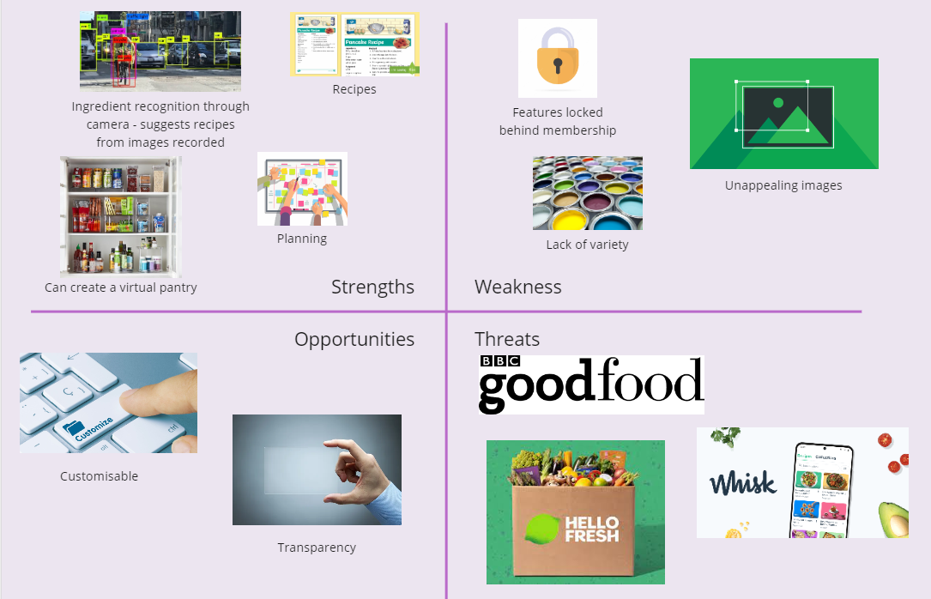
Competitors - Yummly

Slide 13

Competitors - BBC Good Food
Print
Digital
v
v
UK’s top selling food magazine
628,000 readers
130,936 Subscriptions
28% Male readers
72% Female readers
Average age of 45
UK’s biggest food website
94.6 million page views
26 million unique users
36% Male readers
64% Female readers
Average age of 44
Immediate Media (2021) Media pack [online]. London: Immediate Media. Available from: https://www.immediate.co.uk/wp-content/uploads/2021/08/IMFood-Media-pack-2021.pdf [Accessed 13 March 2023]

Slide 14


Logo
Inspiration
Wikipedia (2022) Digital cover featuring artwork by Kino of Pentagon. Available from: https://en.wikipedia.org/wiki/We:th [Accessed 13 March 2023]
Inspiration
Gardner’s Path (2023) Daisies. Available from: https://gardenerspath.com/types-of-daisy/ [Accessed 14 March 2023]
My Logo Idea

Slide 15
Font
Daisy
Daisy
Daisy
Daisy
Daisy
Daisy
Daisy
Daisy
Daisy
Daisy
Daisy
Daisy
Daisy
Daisy
Daisy
Daisy
Daisy
Daisy
Daisy
Daisy

Slide 16
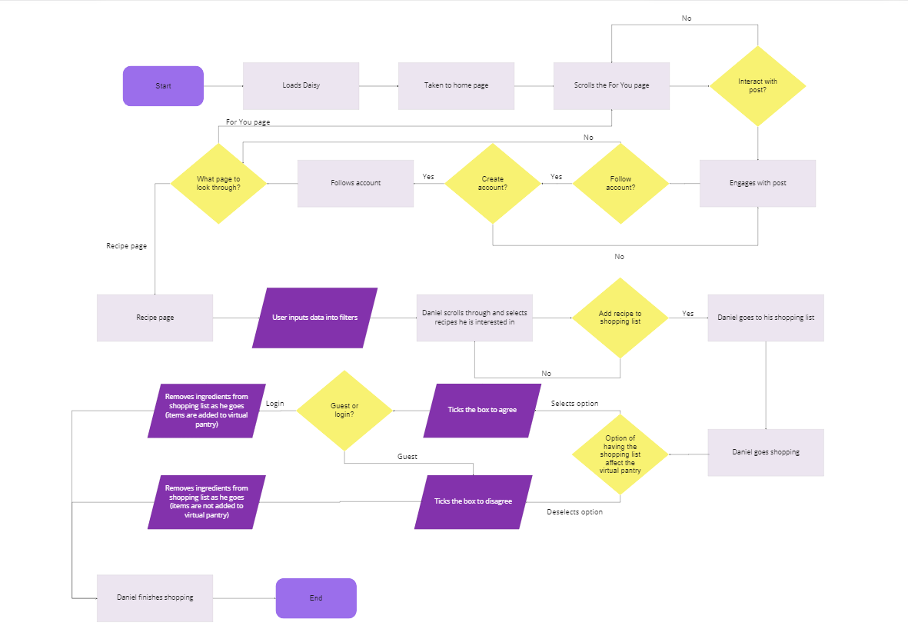

Slide 17
Colour Pallet

